Slide 1

Recycle Management System

Slide 2
Abstract
The Recycle Management System is the process of recycling waste materials by connecting individual users with companies that require recyclable resources. The system enables users to scan and list recyclable items, add them to a cart, and schedule pickups with interested companies based on the material type (e.g., plastic, metal, glass, paper, e-waste, etc.).

Slide 3
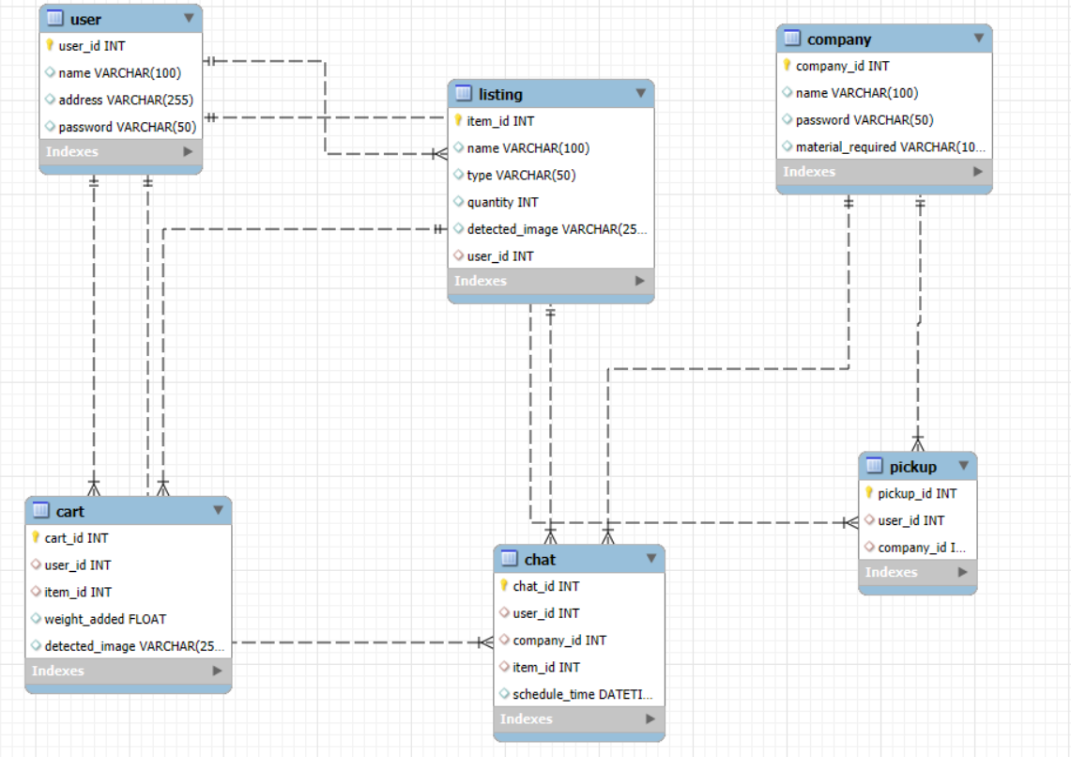
ER Diagram

Slide 4
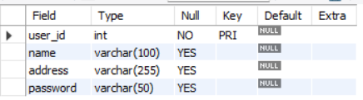
Structure of table
USER Table
Holds basic user information. Each user can:
List recyclable items.
Schedule pickups.
Chat with companies.
SYNTAX: desc user;

Slide 5
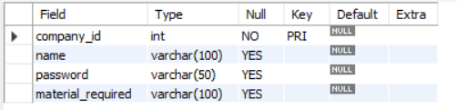
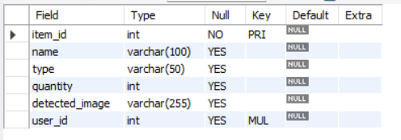
COMPANY Table
Stores company info. Each company:
Picks up items based on the material
they require.
Can chat with users about items.
SYNTAX: desc company;
LISTING table
Items listed by users. Tied to:
A user who created the listing.
The type of recyclable material.
Relationship:
One user -> many listings (1:N)
SYNTAX: desc listing;

Slide 6
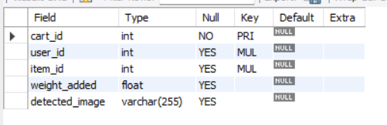
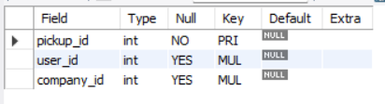
CART table
Shows which items a user added to their cart and how much of it.
Relationship:
User ↔ Cart ↔ Listing (M:N resolved through Cart)
SYNTAX: desc cart;
PICKUP table
Represents which company is picking up from which user.
Relationship:
Many pickups (N:M) → simplified to many rows, one per interaction
SYNTAX: desc pickup;

Slide 7
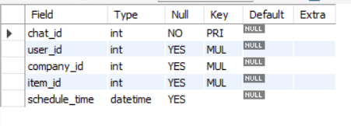
CHAT table
Represents communication and scheduling between a user and a company about a specific item.
Relationship:
Ties together user, company, and listing
chat is the bridge for scheduling
SYNTAX: desc chat;

Slide 8
JOINS

Slide 9
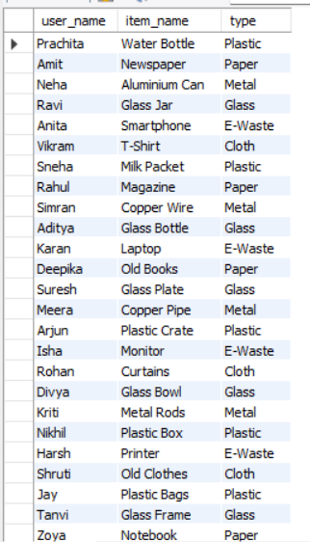
Displays each item listed by users and the material type
SYNTAX:
SELECT u.name AS user_name, l.name AS item_name, l.type
FROM user u JOIN listing l ON u.user_id = l.user_id;

Slide 10
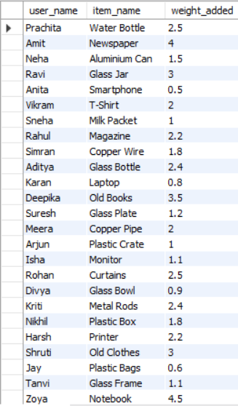
Show what items each user added to their cart and the weight
SYNTAX:
SELECT u.name AS user_name, l.name AS item_name, c.weight_added
FROM cart cJOIN user u ON c.user_id = u.user_id
JOIN listing l ON c.item_id = l.item_id;

Slide 11
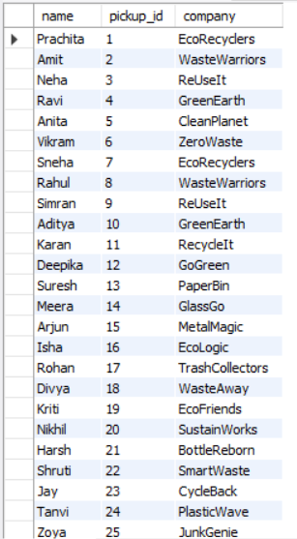
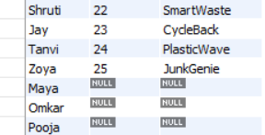
Displays all users, even those who haven't scheduled pickups yet.
SYNTAX:
SELECT u.name, p.pickup_id, co.name AS company
FROM user u
LEFT JOIN pickup p ON u.user_id = p.user_id
LEFT JOIN company co ON p.company_id = co.company_id;

Slide 12
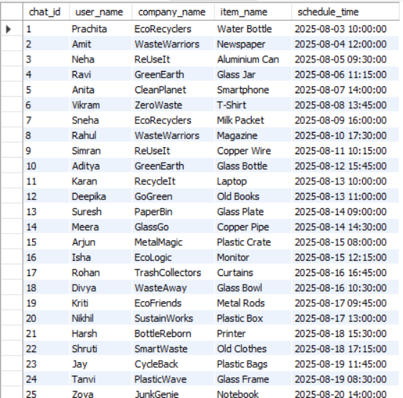
Full info about scheduled chats involving user, company, and item.
SYNTAX:
SELECT ch.chat_id, u.name AS user_name, co.name AS company_name, l.name AS item_name, ch.schedule_time
FROM chat ch
JOIN user u ON ch.user_id = u.user_id
JOIN company co ON ch.company_id = co.company_id
JOIN listing l ON ch.item_id = l.item_id;

Slide 13
SUBQUERY

Slide 14
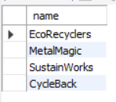
Companies that scheduled a chat for ‘Plastic’ items
SYNTAX:
SELECT name
FROM company
WHERE company_id IN (
SELECT company_id
FROM chat
WHERE item_id IN (
SELECT item_id FROM listing WHERE type = 'Plastic'
)
);

Slide 15

Users who listed more than 2 items
SYNTAX:
SELECT name
FROM user
WHERE user_id IN (
SELECT user_id
FROM listing
GROUP BY user_id
HAVING COUNT(*) > 2
);

Slide 16
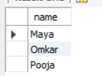
Users who never added anything to the cart
SYNTAX:
SELECT name
FROM user
WHERE user_id NOT IN (
SELECT DISTINCT user_id FROM cart
);

Slide 17
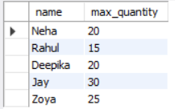
Users whose highest listed item quantity is greater than equal to 15
SYNTAX:
SELECT name, (
SELECT MAX(quantity)
FROM listing
WHERE user.user_id = listing.user_id
) AS max_quantity
FROM user
WHERE (
SELECT MAX(quantity)
FROM listing
WHERE user.user_id = listing.user_id
) > 15;

Slide 18
PROJECT BY PRACHITA SACHIN JADHAV IT VEDANT BATCH T343
THANK YOU

